Slide 1
Modern College of
Arts,Science & Commerce
Bank Management System
By-
Name1 : Tejas Sanjay Andhare
Roll No. : 32104
Name2 : Renuka Rajkumar Khade
Roll No. : 32125

Slide 2
Agenda
System Overview
Technologies Used
Problem definition
Limitation of manual system
Proposed System
Design Specification
Input screen
Features of the System
Limitation
Future Enhancements
Challenges

Slide 3
System Overview
“The Banking Management System is an application for maintaining
a person’s account in a bank”
The Bank management system is an application for maintaining a person’s account in a bank.
The system provides the access to the customer to create an account, deposit/withdraw the cash from his account, also to view reports of all accounts present.
The main purpose of developing bank management system is to design an application, which could store bank data and provide an interface for retrieving customer related details with 100% accuracy.

Slide 4
Technologies Used
SOFTWARE REQUIREMENT
Front End: C#.Net Microsoft Visual Studio 2008
Back End: Microsoft Access

Slide 5
Problem Definition
"The Bank Management System is an application for maintaining a person's account in a Bank." Keeping the track all activities and their record on paper. It is also time-consuming process.
The problem facing the current manual system is difficult to update and maintain inconsistent data and difficult to data backup.
This System Provide a large amount of information storage. The necessary Details are store in database which help to retrieve a data easily.

Slide 6
Problem Definition (Continued..)
Some of the problem with existing system are as follows:
  Lack of security of data.
  More man power.
  Time consuming.
  Consumes large volume of paper work.
  Needs manual calculations.
  Damage of machines due to lack of attention.

Slide 7
Limitation Of The Manual System
Current System can be handled by only one user .
Time Consuming and costly to produce reports.
Lack of Security.
All the manual entry and editing will take more time.

Slide 8
Proposed System
Objective:
In Bank Management System Project we are mainly developing a banking system where a customer can submit their deposit amount, create new account, view status or balance of account of the bank. they can easily maintain their account by login through his unique account number.
The aim of proposed system is to develop a system of improved facilities. The
proposed system can overcome all the limitations of the existing system.
Some are following features as follow:
  Security of data.
  Minimum time needed for the various processing.
  Better service.
  Minimum time required.

Slide 9
List of Processes within the System
List of Processes within the System :
  Registration Process
  Login Process
  Dashboard
  Deposit Amount Process
  Withdraw Amount Process
  Transfer Amount Process
  Fixed Deposit Amount Process
  Bank Branch Management Process
  Employee Management Process
  Services

Slide 10
Design Specification

Slide 11
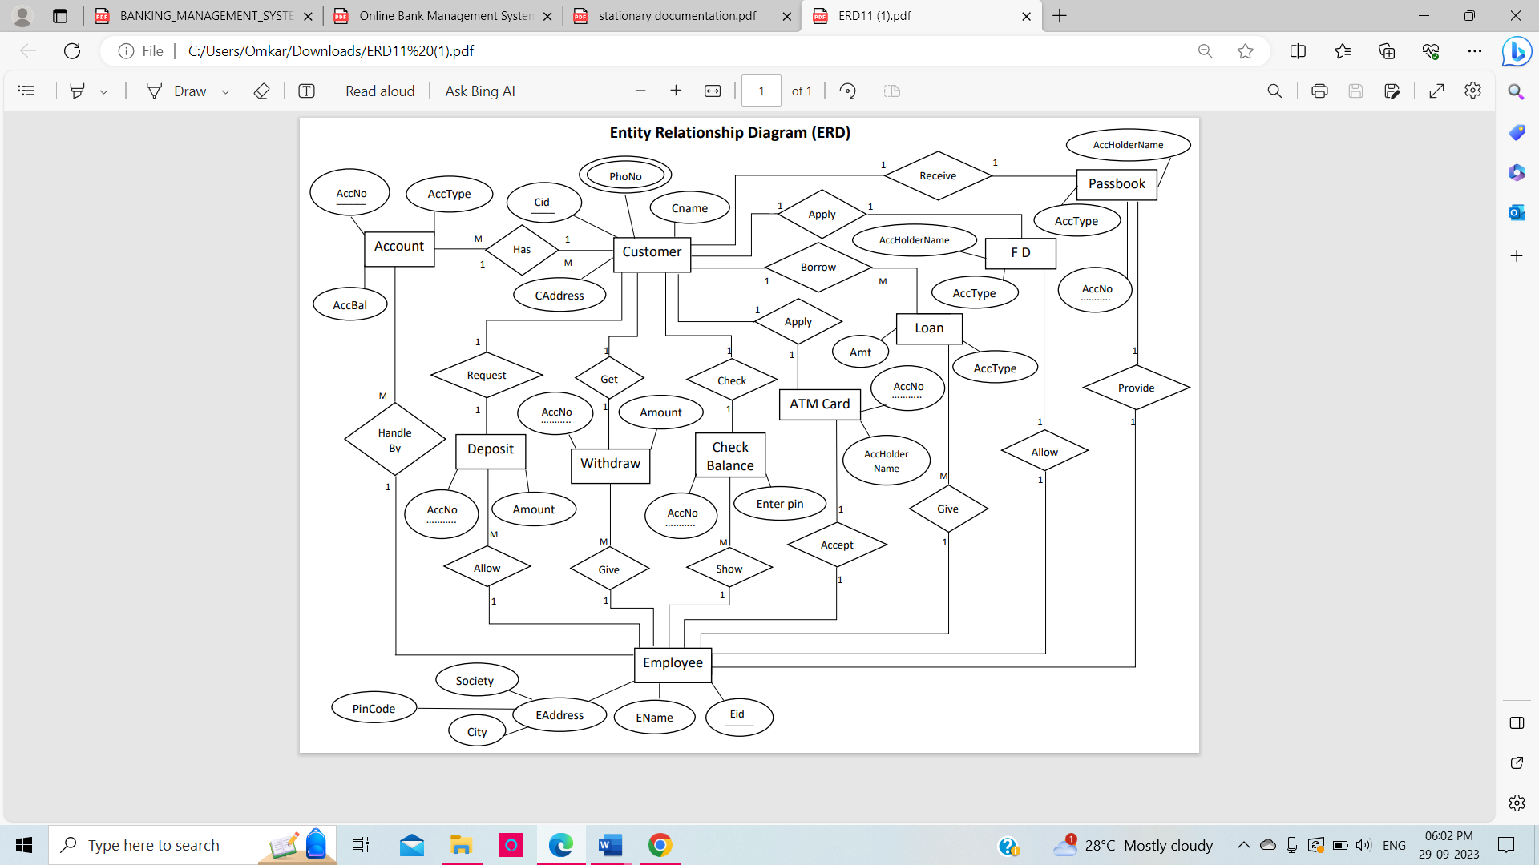
E R Diagram

Slide 12
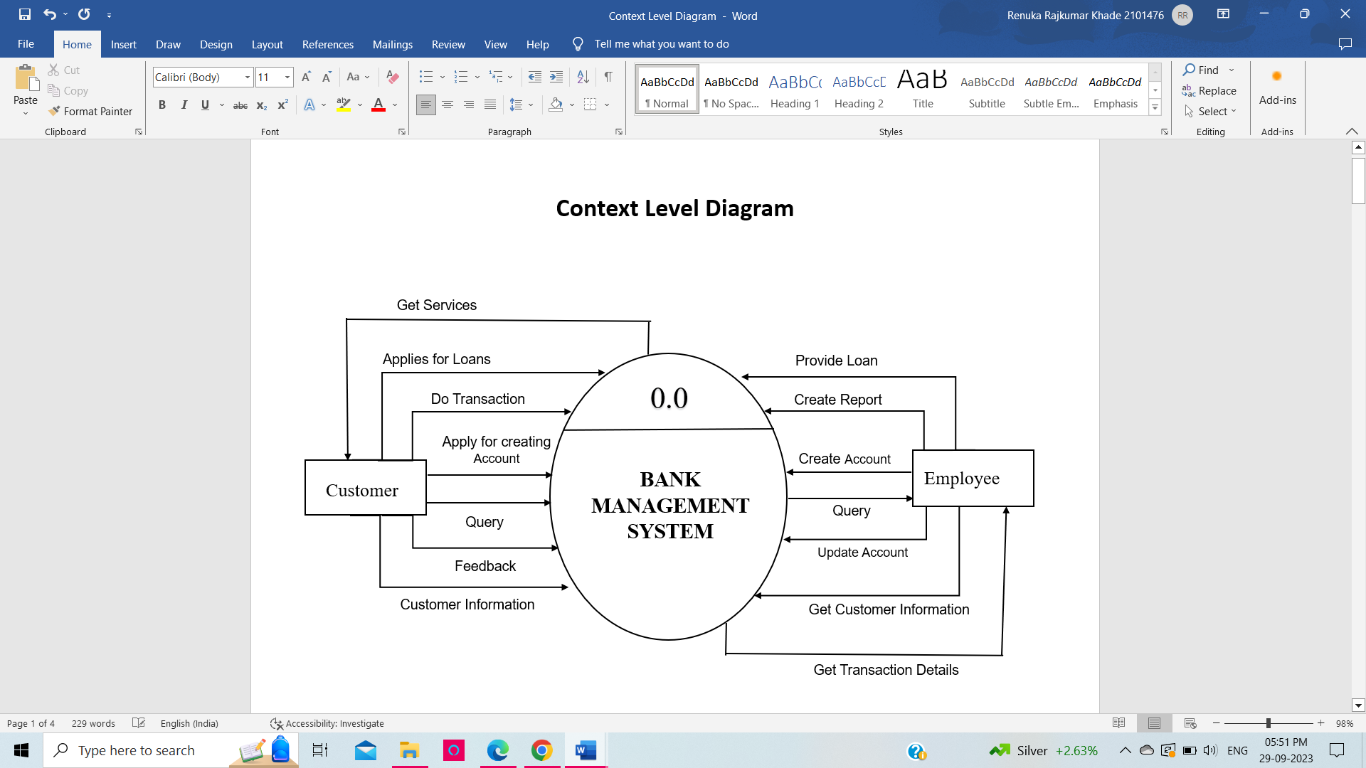
Context level DFD’s

Slide 13
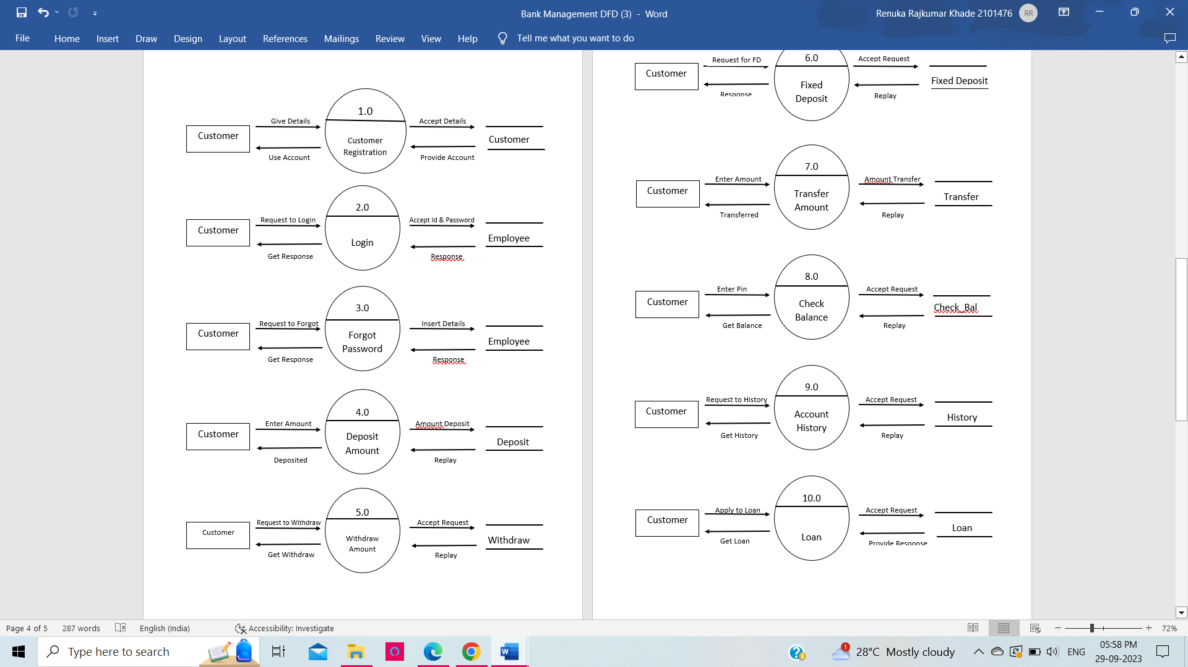
First Level DFD

Slide 14
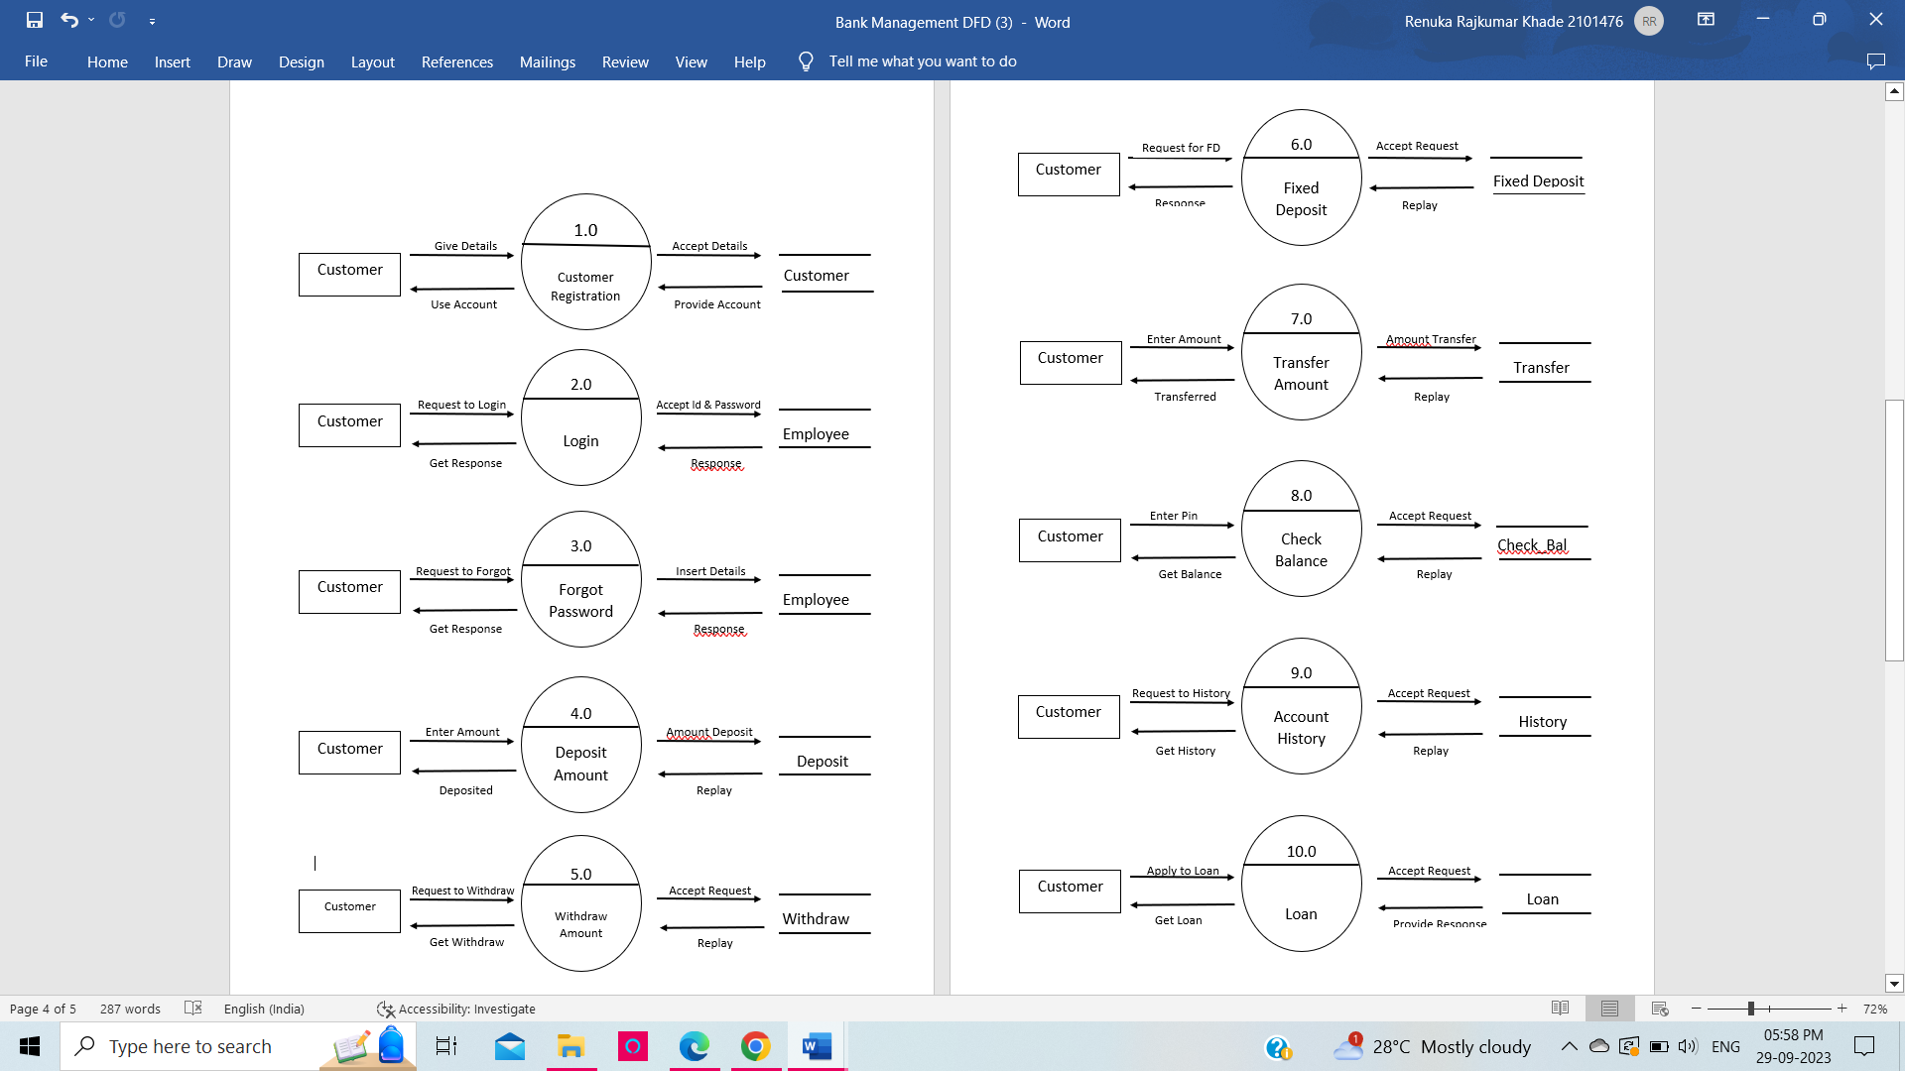
First Level DFD

Slide 15
Features of System
The system is very simple in design and to implement.
It has got following features:-
Easy to update information
Decreased the load of person involved in existing manual system
Security of data.
Minimum time needed for the various processing.
User friendliness and interactive.

Slide 16
Limitation Of the System
There is no facility yet to produce customized reports
The System needs to maintain a large amount of information.
Every information needs to be maintained manually in registers.
All the manual entry and editing will take more time.
Safety of paper documents from the disaster.

Slide 17
Future Enhancement
This project can be handled in future by doing various modifications like: -
We can go further for Online Banking.
We can establish and start various Branches and available help centers for Account Holder’s Queries.
We can also deal through internet by creating web pages and a banking website for internet dealing.
To attract Account Holder’s we can offer various offers during festivals months.

Slide 18
Challenges
Less Time
Hardware and Software requirement.
Continuous Changing Demand

Slide 19
THANK YOU

